Slide 1

myDNS
Informática de Gestão
2019/2020

Slide 2
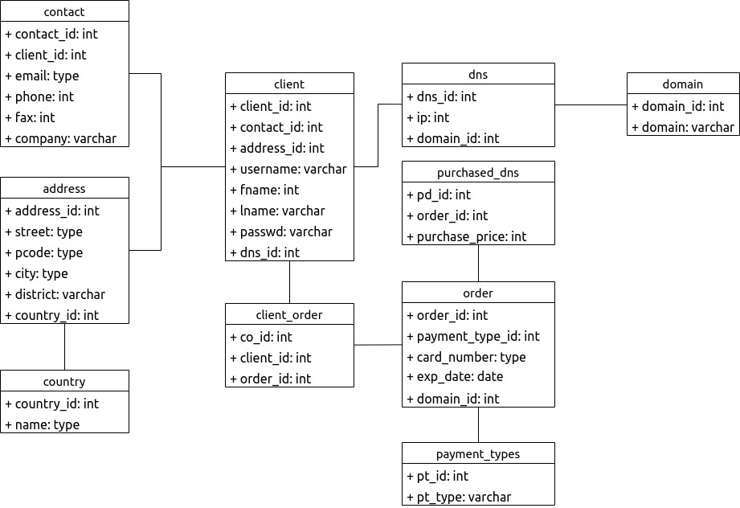
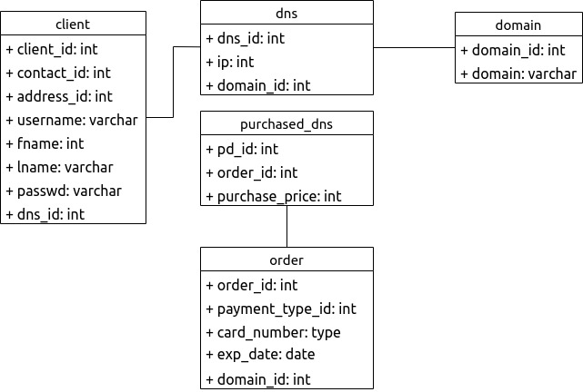
myDNS
Domain Model
Planned
Implemented

Slide 3
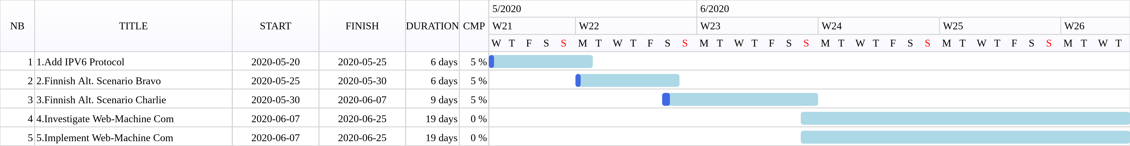
myDNS
Planification
Service used: https://www.drawgantt.com

Slide 4
DEMO AWAITS!

